Slide 1
The Basics of Biotechnology
Plasmids and Restriction enzymes

Slide 2
Content of Lecture
Basics of Biotechnology/terminologies
Making of a recombinant DNA technology
Golden rice genetically modified Rice
© 2013 Pearson Education, Inc.

Slide 3
What Is Biotechnology and What Does It Mean to You?
Biotechnology – using living organisms, or the products of living organisms, for human benefit to make a product or solve a problem
Historical Examples
Fermentation
Selective breeding
Use of antibiotics
© 2013 Pearson Education, Inc.

Slide 4
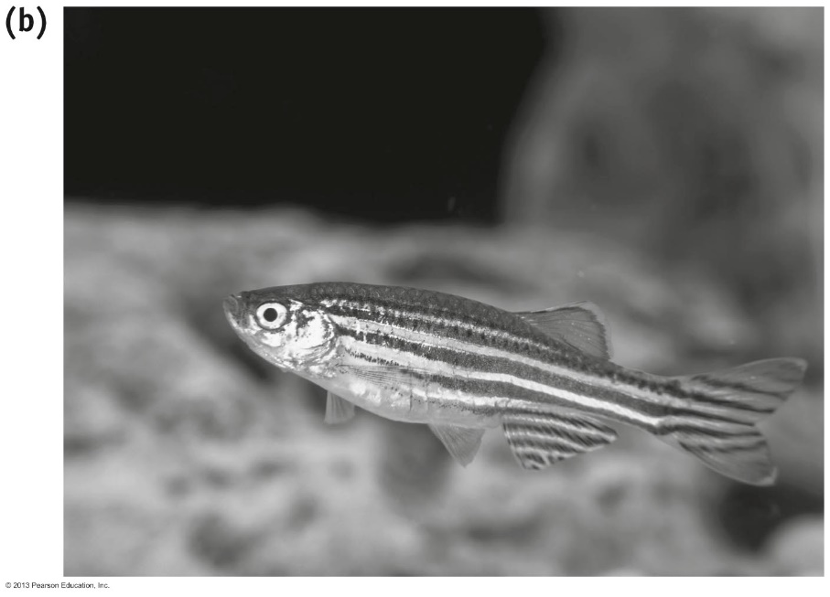
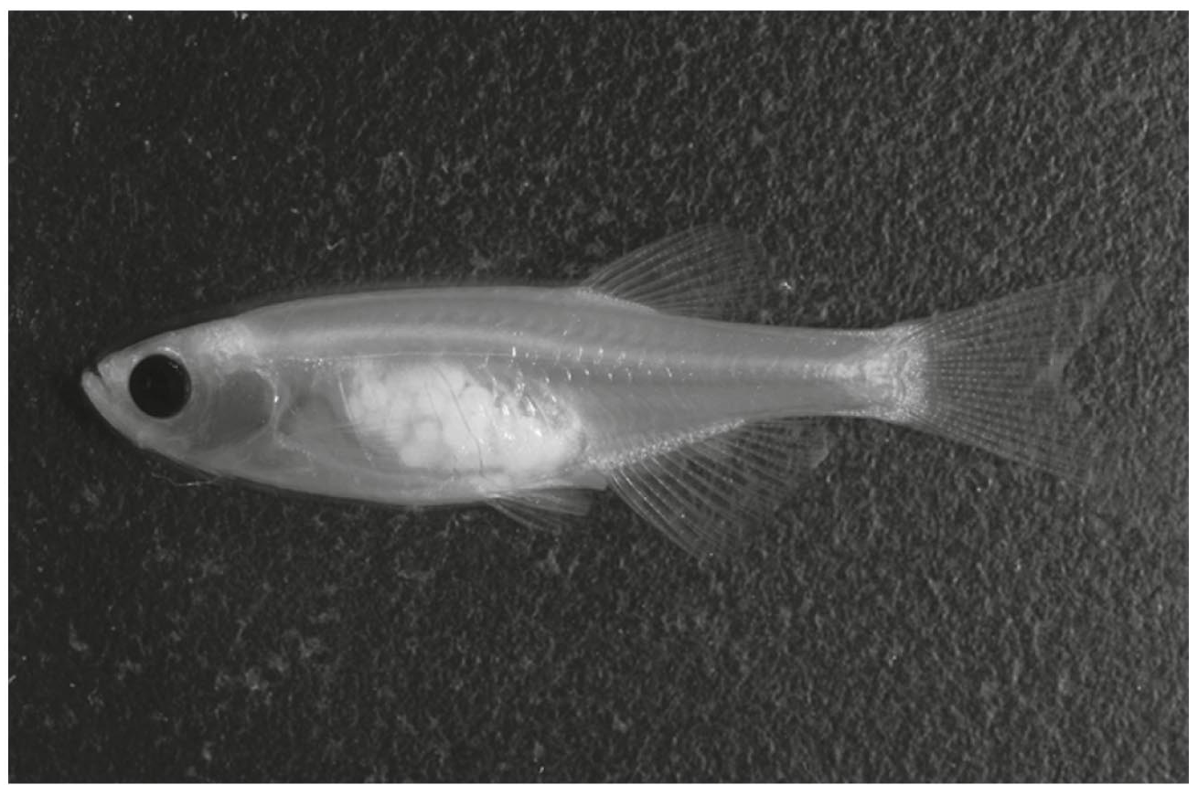
1.1 What Is Biotechnology and What Does It Mean to You?
Example of Biotechnology – Selective Breeding
What feature of Casper makes it a "model organism" to study migration of cancer cells compared to wildtype fish?
(a)
(b)
Normal zebrafish
"Casper" zebrafish – made by selective breeding
© 2013 Pearson Education, Inc.
Notes:
Answer: Via selective breeding, by mating a zebrafish mutant that lacked reflective pigment with a zebrafish that lacked black pigment, Casper is transparent. This feature allows scientists to inject fluorescent cancer cells into Casper's abdominal cavity and then track the migration of those cells to specific locations in his body.

Slide 5
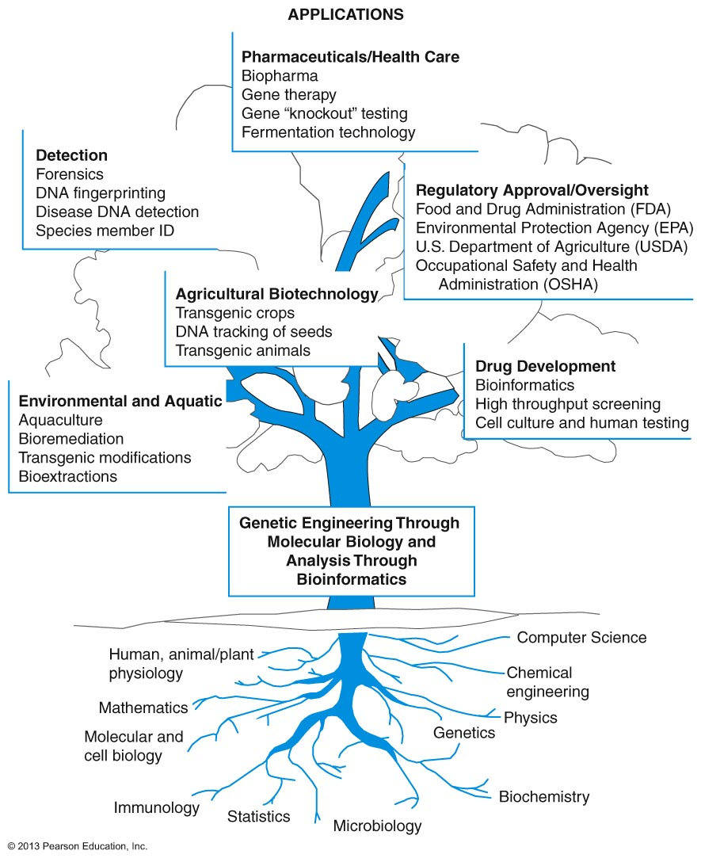
1.1 What Is Biotechnology and What Does It Mean to You?
Based on this tree, can you become successful in the biotech industry only studying biology?
© 2013 Pearson Education, Inc.
Notes:
Answer: No, you need to take many science courses including biology, computer science, chemistry, math (especially statistics). If you are not broadly trained, you will not be able to obtain a job in this growing field!

Slide 6
1.1 What Is Biotechnology and What Does It Mean to You?
Modern Examples
Gene cloning
Genetic engineering
Recombinant DNA technology
Human Genome Project
© 2013 Pearson Education, Inc.

Slide 7
1.1 What Is Biotechnology and What Does It Mean to You?
Example of "modern" biotechnology:
recombinant DNA technology started modern biotech as an industry
Examples of applications
development of disease-resistant plants
food crops that produce greater yields
"golden rice" engineered to be more nutritious
genetically engineered bacteria that can degrade environmental pollutants
Work in groups to come up with more examples of applications
© 2013 Pearson Education, Inc.
Notes:
Answer: The answers will vary.
Low cost production of proteins used to treat diseases
Development of recombinant enzymes to be used by molecular biologists for research
Students can come up with many more great ideas. This exercise really makes students stretch their imaginations and they really enjoy working together to generate great ideas!

Slide 8
GMOs and Transgenic Organisms
Transgenic
An organism that has been genetically modified with genes from a different species
Genetically modified organisms (GMOs)
Organism whose genome has been modified by genetic engineering

Slide 9
10.2 Finding Needles in Haystacks
Gene research was limited until enzymes produced by bacteria to cut viral DNA were discovered
Restriction enzyme
Enzyme that cuts DNA at specific base sequences
Used in DNA cloning to cut DNA into pieces that are inserted into cloning vectors

Slide 10
DNA Cloning
DNA cloning mass-produces DNA fragments for research
DNA cloning
Set of procedures that uses living cells to make many identical copies of a DNA fragment
Clone
A genetically identical copy of DNA, a cell, or an organism

Slide 11
Cloning Vectors
Cloning vector
A DNA molecule that can accept foreign DNA, resulting in a hybrid molecule that can be transferred to a host cell, and get replicated in it
Plasmid
A small, circular DNA molecule in bacteria, replicated independently of the chromosomes
A cloning vector

Slide 12
Recombinant DNA
Recombinant DNA molecules are introduced into host cells such as bacteria, which copy the DNA as they divide
Recombinant DNA
Contains genetic material from more than one organism

Slide 14
Plasmids

Slide 15
Plasmids
At their most basic level, plasmids are small circular pieces of DNA that replicate independently from the host’s chromosomal DNA.
They are mainly found in bacteria, but also exist naturally in archaea and eukaryotes such as yeast and plants.
In nature, plasmids provide one or more functional benefits to the host such as resistance to antibiotics, degradative functions, and/ or virulence.

Slide 16
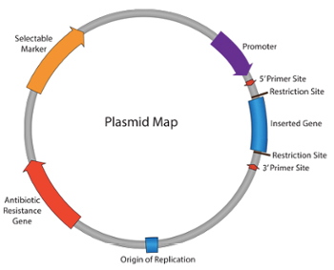
Plasmid Map

Slide 17
Plasmid / plasmids

Slide 18

Plasmid / plasmids
Plasmids have a wide range of lengths, from roughly one thousand DNA base pairs to hundreds of thousands of base pairs. When a bacterium divides, all of the plasmids contained within the cell are copied such that each daughter cell receives a copy of each plasmid.
Bacteria can also transfer plasmids to one another through a process called conjugation.

Slide 19
Plasmid / plasmids
Scientists have taken advantage of plasmids to use them as tools to clone, transfer, and manipulate genes.
Plasmids that are used experimentally for these purposes are called vectors. Researchers can insert DNA fragments or genes into a plasmid vector, creating a so-called recombinant plasmid.
This plasmid can be introduced into a bacterium by way of the process called transformation. Then, because bacteria divide rapidly, they can be used as factories to copy DNA fragments in large quantities.

Slide 21
RESTRICTION ENZYMES
Restriction enzyme, also called restriction endonuclease, a protein produced by bacteria that cleaves DNA at specific sites along the molecule. In the bacterial cell, restriction enzymes cleave foreign DNA, thus eliminating infecting organisms.
Restriction enzymes can be isolated from bacterial cells and used in the laboratory to manipulate fragments of DNA, such as those that contain genes; for this reason they are indispensible tools of recombinant DNA technology (genetic engineering).

Slide 22
Plasmid / plasmids

Slide 23
RESTRICTION ENZYMES
A bacterium uses a restriction enzyme to defend against bacterial viruses called bacteriophages, or phages.
When a phage infects a bacterium, it inserts its DNA into the bacterial cell so that it might be replicated.
The restriction enzyme prevents replication of the phage DNA by cutting it into many pieces.
Restriction enzymes were named for their ability to restrict, or limit, the number of strains of bacteriophage that can infect a bacterium.

Slide 25
RESTRICTION ENZYMES
Each restriction enzyme recognizes a short, specific sequence of nucleotide bases (the four basic chemical subunits of the linear double-stranded DNA molecule—adenine, cytosine, thymine, and guanine).
These regions are called recognition sequences and are randomly distributed throughout the DNA. Different bacterial species make restriction enzymes that recognize different nucleotide sequences.

Slide 29
Making Recombinant DNA
1. A restriction enzyme recognizes specific base sequences in DNA from two different sources
2. Restriction enzymes cut DNA into fragments with single-stranded tails (“sticky ends”)
3. DNA fragments from different sources are mixed together; matching sticky ends base-pair
4. DNA ligase joins fragments, forming recombinant DNA

Slide 30
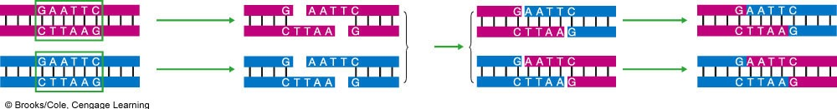
Making Recombinant DNA
restriction enzyme (cut)
mix
DNA ligase (paste)
1 A restriction enzyme recognizes a specific base sequence in DNA (green boxes) from two sources.
2 The enzyme cuts DNA from both sources into fragments that have sticky ends.
3 The DNA fragments from the two sources are mixed together.
The matching sticky ends base-pair with each other.
4 DNA ligase joins
the fragments of DNA where they overlap. Molecules of recombinant DNA
are the result.
Fig. 10-2, p. 181
Notes:
Figure 10.2
Making recombinant DNA.

Slide 32
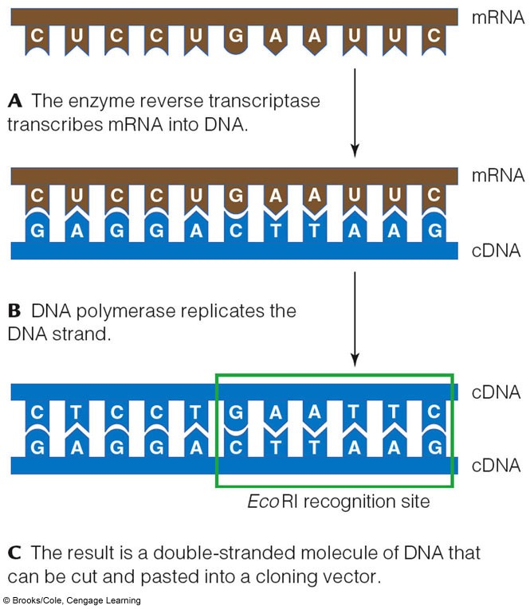
The Plasmid Cloning Cycle

Slide 34
Step 2: Transformation
Recombinant DNA is introduced into bacterial cells through a transformation process that allows bacteria to make copies of the recombinant DNA.
Bacteria can absorb genetic material from their environment. Scientists have optimized this process to facilitate cloning experiments.
The most common transformation technique used in laboratories today utilizes chemically competent cells, which have been treated with calcium chloride to allow the attachment of plasmid DNA to the cell membrane.

Slide 35
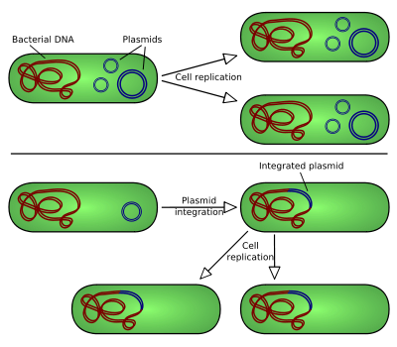

Slide 36
THREE TYPES OF PLASMIDS CAN RESULT FROM CLONING:
1. The vector can re-ligate back to itself (plasmid with no insert).
2. A fragment without the DNA of interest can ligate into the vector (plasmid with the wrong insert).
3. The DNA of interest fragment can ligate into the vector (plasmid with correct insert).

Slide 37
Blue-white screening is a common screening technique, where the bacteria will appear blue or white depending on the presence of a plasmid. This is due to the plasmid containing a specific functional feature—LacZα.
When LacZα is disrupted by cloning into the MCS, B-galactosidase is not produced, and the bacteria appear white instead of blue.

Slide 38
Step 4: Extraction from Bacteria
Once candidate clones are identified, small bacterial cultures are inoculated so that DNA can be extracted for analysis.
Then using a DNA mini-prep, a rapid preparation of small amounts of plasmid DNA, the DNA is extracted.
Currently, there are many DNA mini-prep kits available on the market that you can use.

Slide 40


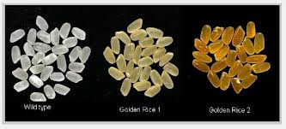
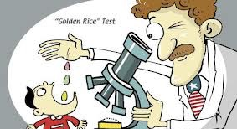
Golden Rice: A boon or bane?

Slide 41
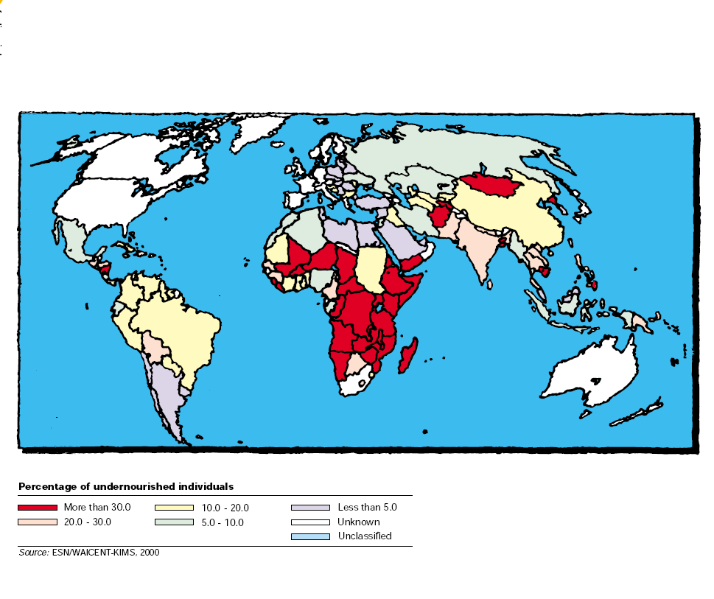
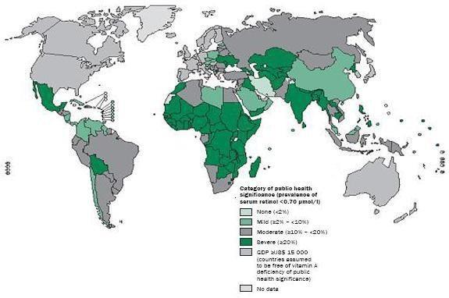
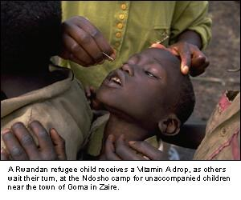
Malnutrition and VAD

Slide 42
β-Carotene Pathway Problem in Plants
IPP
IPP
Geranylgeranyl diphosphate
Geranylgeranyl diphosphate
Phytoene synthase
Daffodil gene
Phytoene synthase
Phytoene
Phytoene
Rice lacks
these enzymes
Phytoene desaturase
Complete Vitamin A Pathway
Phytoene desaturase
Single bacterial gene;
performs both functions
ξ-carotene desaturase
ξ-carotene desaturase
Lycopene
Lycopene
Lycopene-beta-cyclase
Daffodil gene
Lycopene-beta-cyclase
β -carotene
(vitamin A precursor)
β -carotene
(vitamin A precursor)

Slide 43
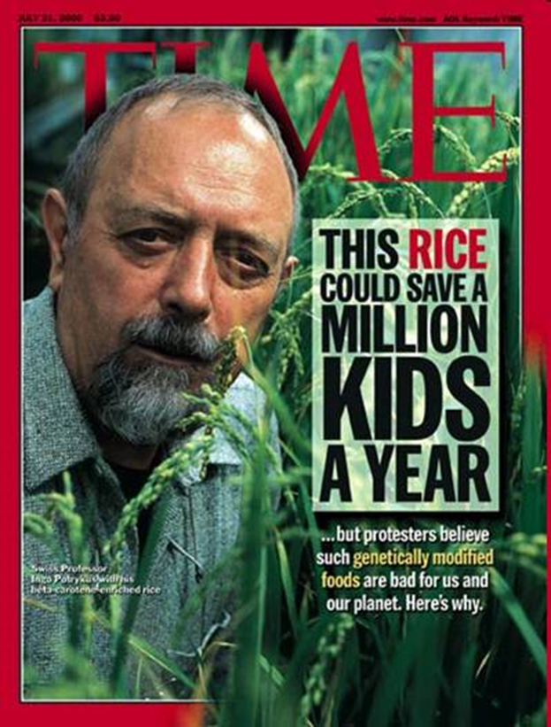
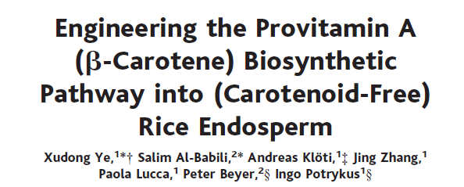
Production of Golden rice 1

Slide 44
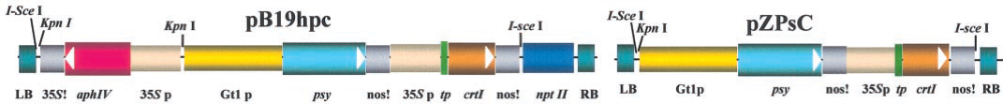
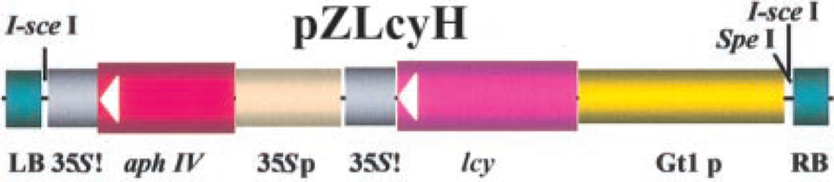
Production of Golden rice 1
Single tranformation
Co-tranformation

Slide 45
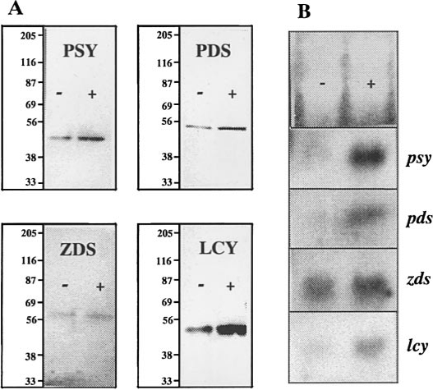
Confirmation of transformation by Northern and Western Blots

Slide 46
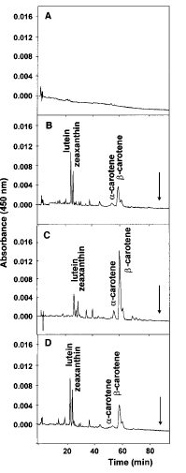
HPLC analysis of the carotenoid extracts

Slide 47
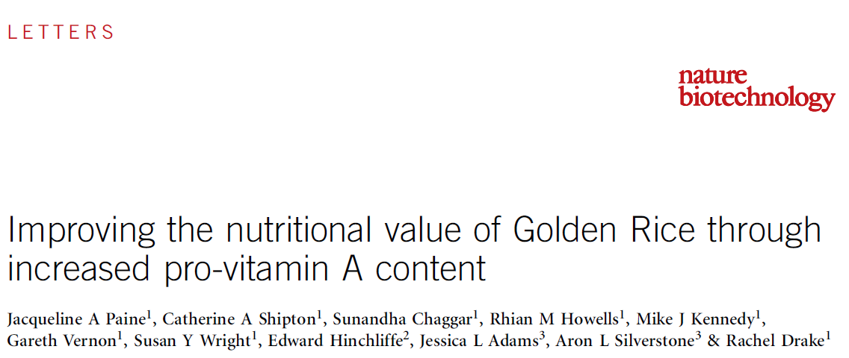
Golden rice 2

Slide 48
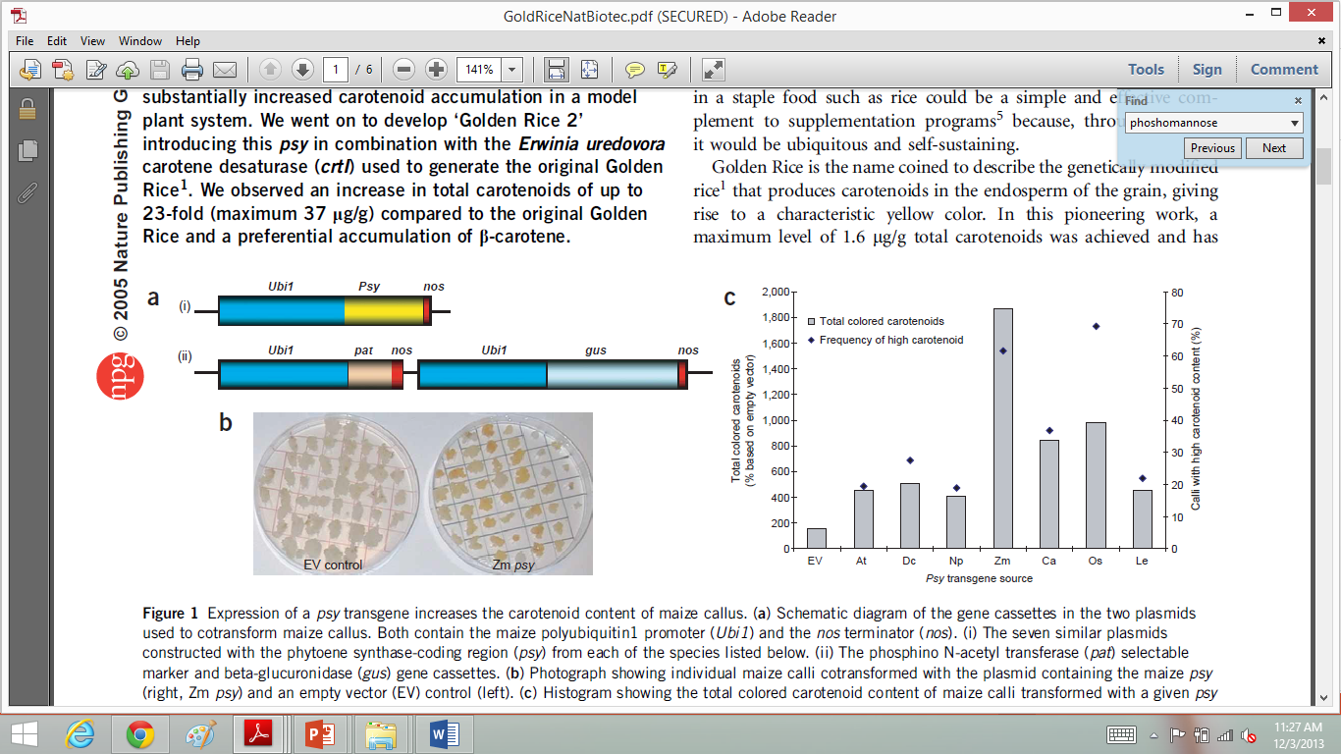
Carotenoid enhancement in rice by introduction of psy orthologues and crtl

Slide 49
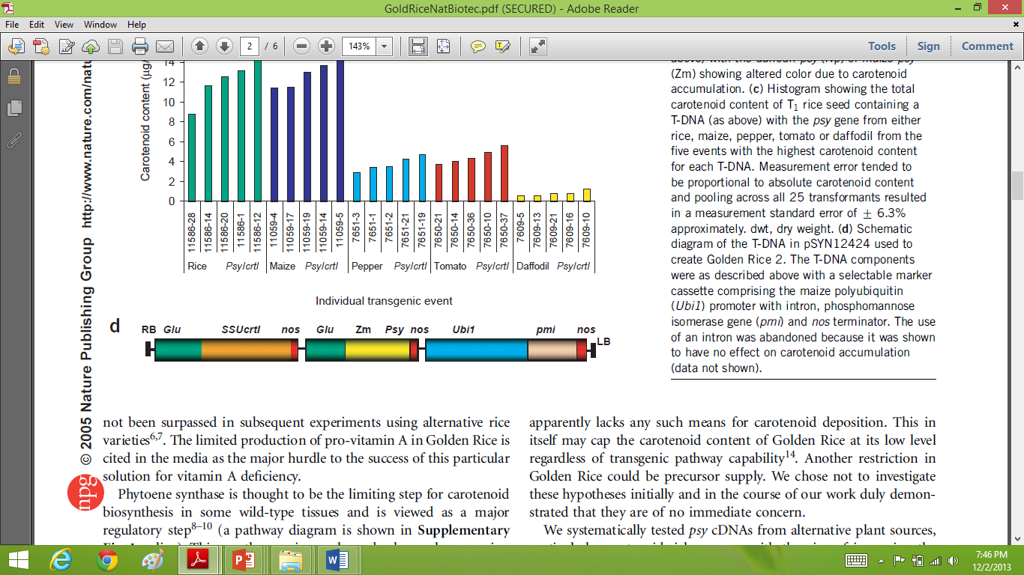
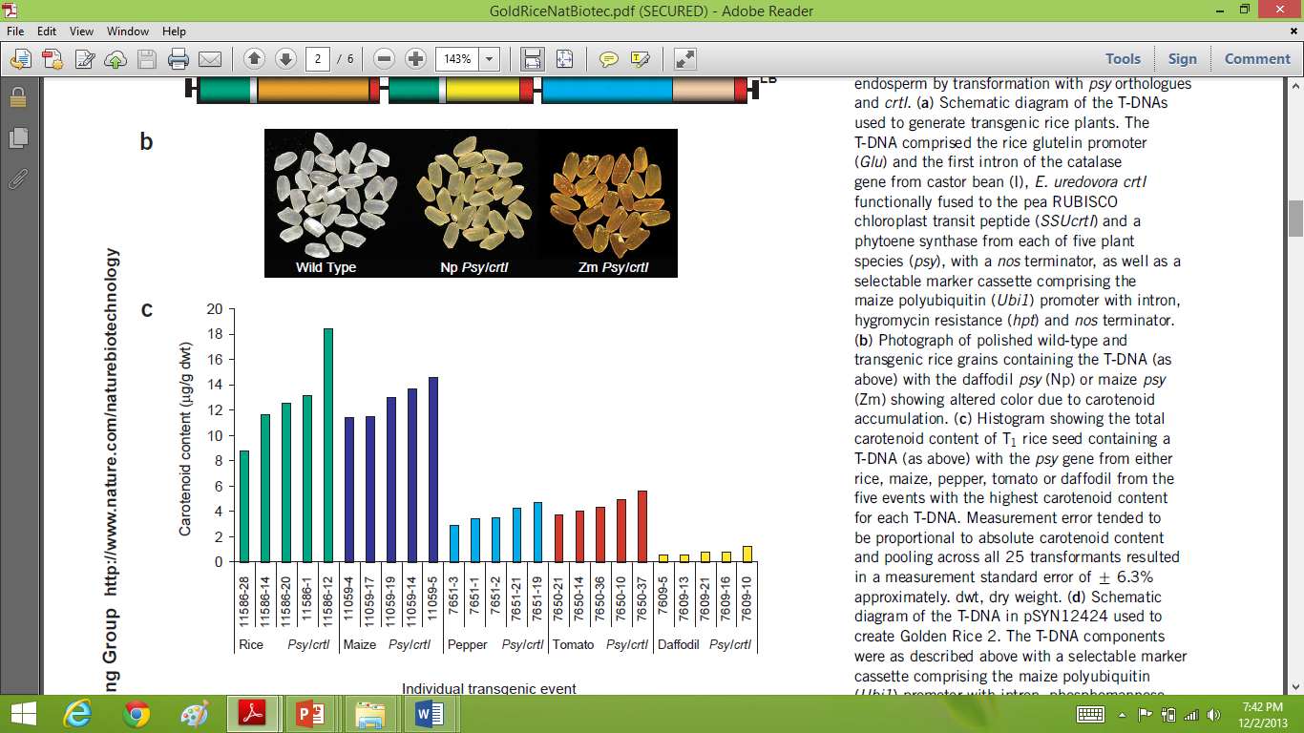
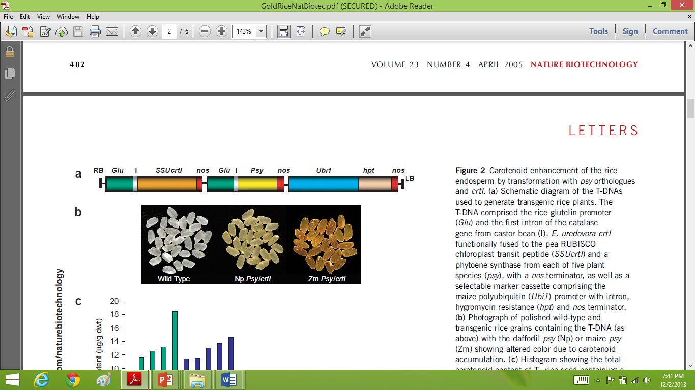
Carotenoid enhancement in rice by introduction of psy orthologues and crtl

Slide 50
Differences between Golden rice 1 and 2
35 μg of carotinoids per gram of dry Golden rice 2 instead of 1.6 μg of carotinoids per gram of dry Golden rice 1.
More efficient phy gene introduced.
Removal of CaMV 35S by polyubiquitin gene.
Incorporation of phosphomannose-isomerase sugar-based selection system instead of antibiotic selection system.

Slide 51
Human trials
Golden Rice 2 plants were grown hydroponically with heavy water (deuterium oxide) to generate deuterium-labeled [²H]β-carotene in the rice grains.
Golden Rice servings of 65–98 g (130–200 g cooked rice) containing 0.99–1.53 mg β -carotene were fed to 5 healthy adult volunteers (3 women and 2 men) with 10 g butter.
A reference dose of [¹³C10]retinyl acetate (0.4–1.0 mg) in oil was given to each volunteer 1 week before ingestion of the Golden Rice dose.
Blood samples were collected over 36 d.

Slide 52
Results
Human trial resulted in a speculation that 50 g uncooked Golden Rice, which is a reasonable serving size for children aged 4–8 y in rice eating regions, who eat ~130–200 g rice/d , would be able
to provide >90% of vitamin A estimated average requirement (EAR) (275 μg retinol/d) or >60% of the Recommended Dietary Allowance (RDA) which is 400 μg retinol/d.

Slide 53
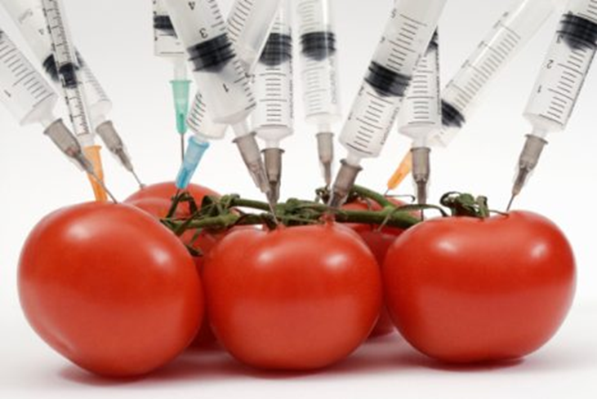
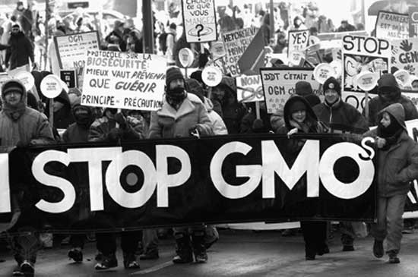
Opposition and delay
People perceive anything involving human manipulation as being highly unnatural.

Slide 54
Issues surrounding commercialization of Golden rice
Social
Political
Environmental

Slide 55
Major concerns
Eat several kilograms of it to get their daily requirement.
Will change the food habit of the developing countries
Small farmers will lose their land and income for being unable to compete with the corporate industries

Slide 56
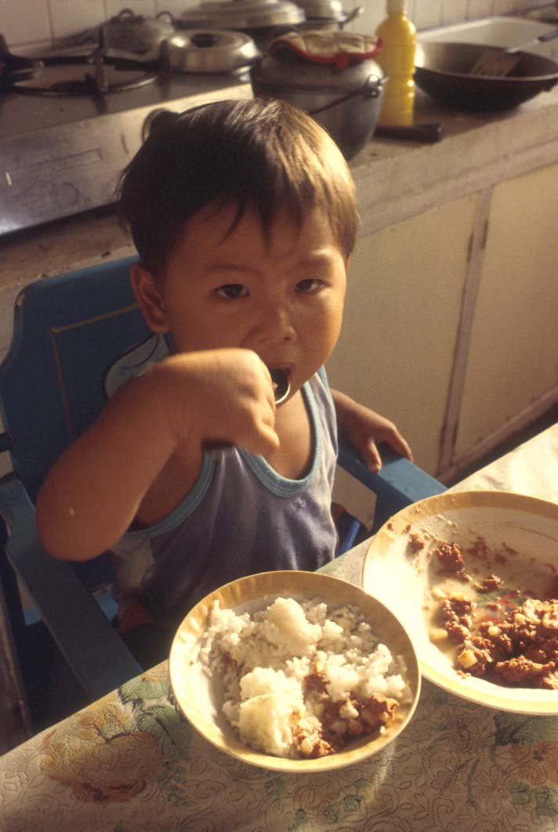

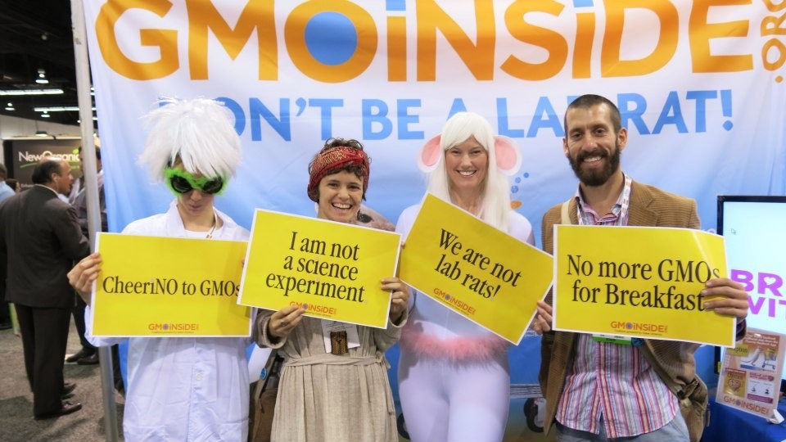
Conclusion
“Public sentiment is everything. With public sentiment, nothing can fail. Without it, nothing can succeed.” – Abraham Lincoln.

